Slide 1
Project SIT
Heart Disease classification
Tutor: Do Quoc Binh
Group 1:
Nguyen Thi Lan Anh
Nguyen Thanh Hung
Dinh Huy Hoang

Slide 2
Table of contents
Part 1: Stats Heart Disease dataset
Part 2: Data processing
Part 3: Build model
Part 4: Result
Part 5: Evaluation
Part 6: Improvement

Slide 3
Part 1: Stats Heart Disease dataset

Slide 4
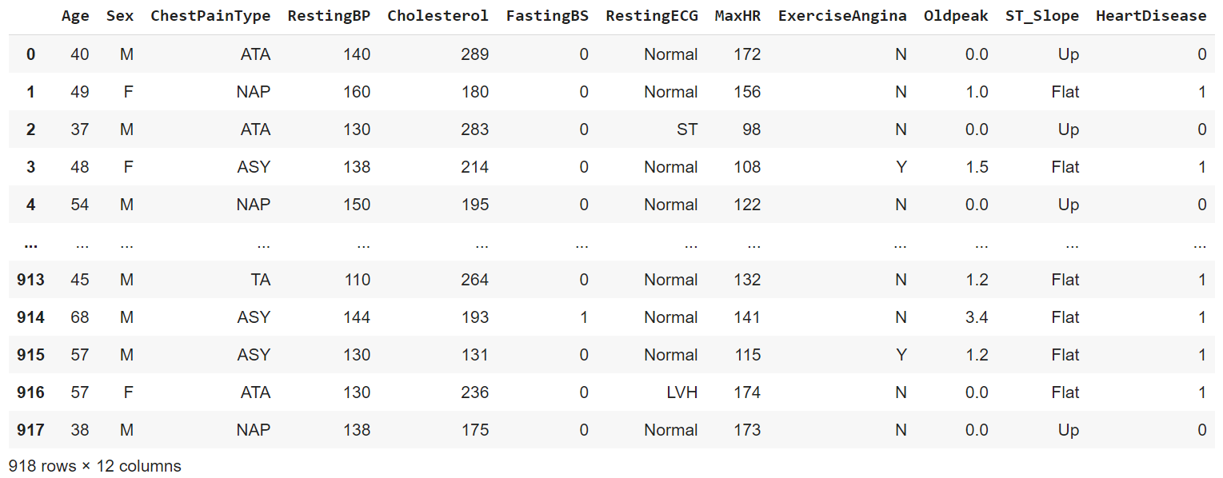
Dataset

Slide 5
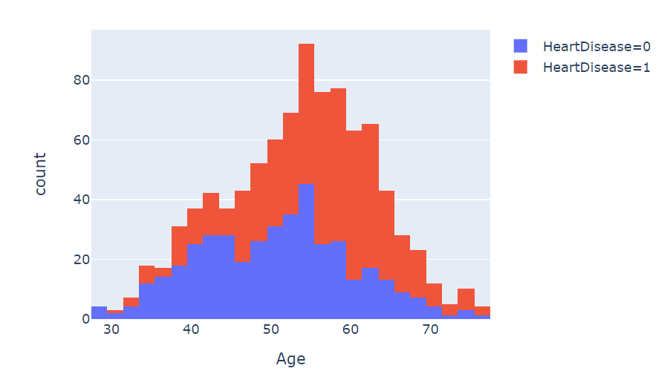
Age and Heart Disease
Age: 50 - 65 has higher risk of heart disease

Slide 6
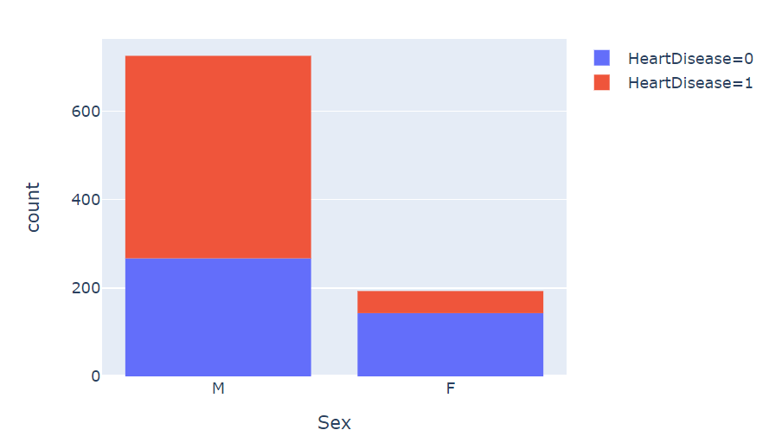
Sex and Heart Disease
Men has very higher risk than women

Slide 7
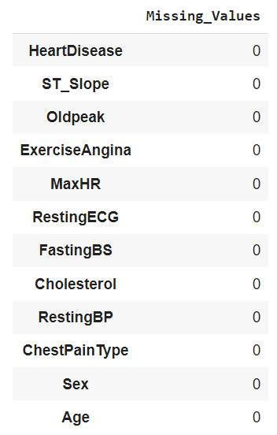
Missing values
Total none values equal to zero
No missing values

Slide 8
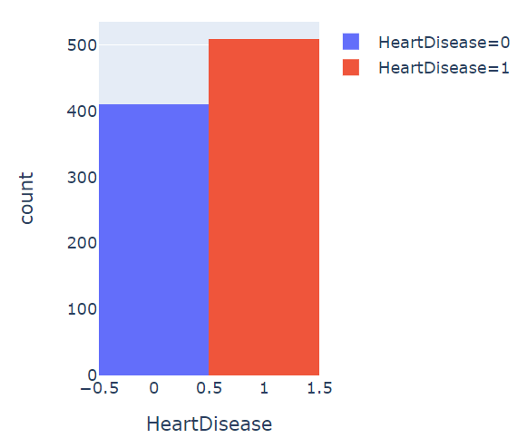
Distribution of target
Class 0: 44.622%
Class 1: 55.338%
Not really high imbalance
Using accuracy metrics for evaluation

Slide 9
Part 2: Data processing

Slide 10
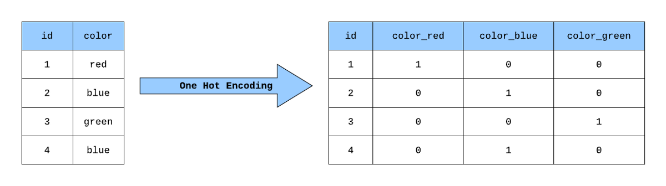
Handle categorical columns
One-hot encoding

Slide 11
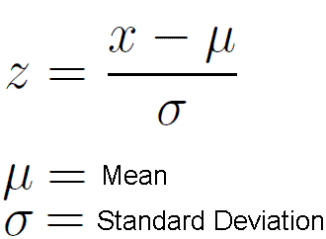
Data normalization
Standard scaler

Slide 12
Part 3: Build model

Slide 13
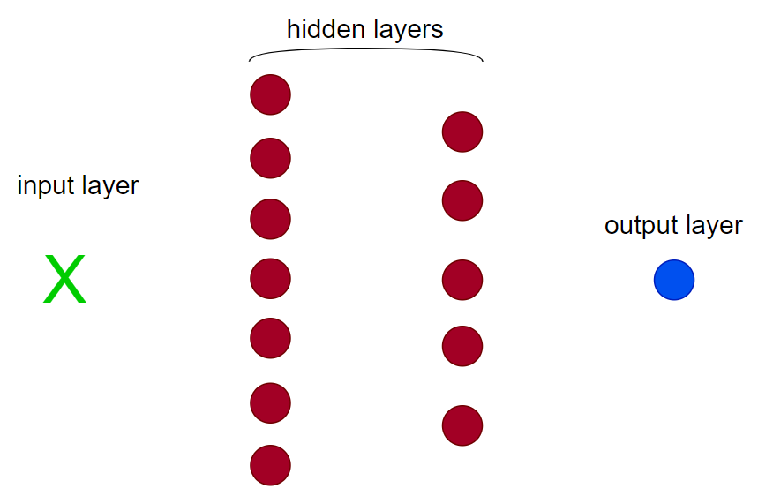
Structure of model
2 hidden layers:
Layer 1: 7 nodes
Layer 2: 5 nodes
Activation: ReLU
Output layer:
1 nodes
Activation: Sigmoid

Slide 14
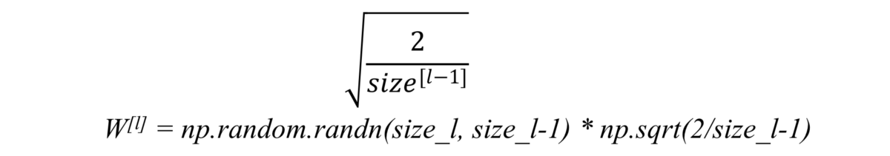
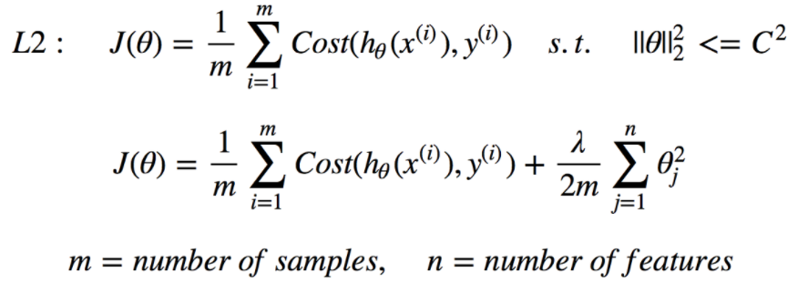
Our techniques to improve performance
He initialization: Avoid exploding/vanishing gradient
2. Regularization term/ weight decay: reduce overfitting

Slide 15
Hyper-parameters
Epochs: 15000
Learning rate: 0.01
Alpha: 0.9

Slide 16
Part 4: Result

Slide 17
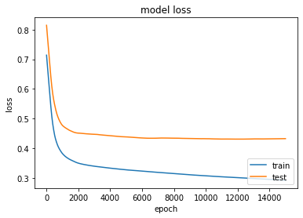
Loss
Training loss: 0.29
Testing loss: 0.43

Slide 18
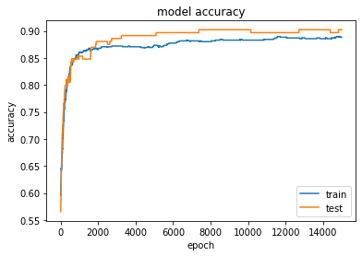
Accuracy
Training accuracy: 0.89
Testing loss: 0.9

Slide 19
Part 5: Evaluation

Slide 20
Name | Layer dims | Train accuracy | Test accuracy
Version 1 (on class) | 7 - 5 - 1 | 0.91 | 0.86
Version 1 (us) | 16 - 4 - 1 | 0.92 | 0.89
Version 2 (us) | 7 - 5 - 1 | 0.89 | 0.90
Version 3 (us) | 7 - 5 - 1 | 0.88 | 0.88
Logistic Regression | 1 | 0.87 | 0.86
Keras | 7 - 5 - 1 | 0.89 | 0.88

Slide 21
Part 6: Improvement

Slide 22
Collect more dataset in many different area and latest years
More experiment
Improve others optimization methods
Provide more reducing overfitting methods
Deploy in center hospitals

Slide 23
Any questions?

